Slide 1

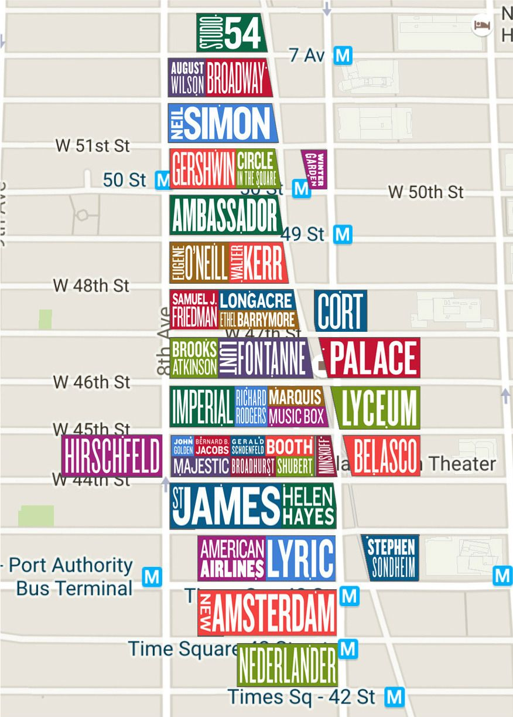
Is “Show Business”
Big Business?
An investigation of data analytics
as applied to Broadway theaters
CAP 1788: Term Project
Carlos Gomez
Amy Rubinson
Spring 2024
Time: 30 sec
Notes:
Carlos

Slide 2
Topic and Guiding Questions
Is “Show Business” big business?
What were the KPIs in 2015?
Which Broadway shows were the greatest* in a specified time period?
* Greatest is defined within each visual, and includes consideration of gross revenue, average ticket price, number of
tickets sold, percent of seats filled, and total number of performances.
Time: 1 min
Notes:
Carlos

Slide 3
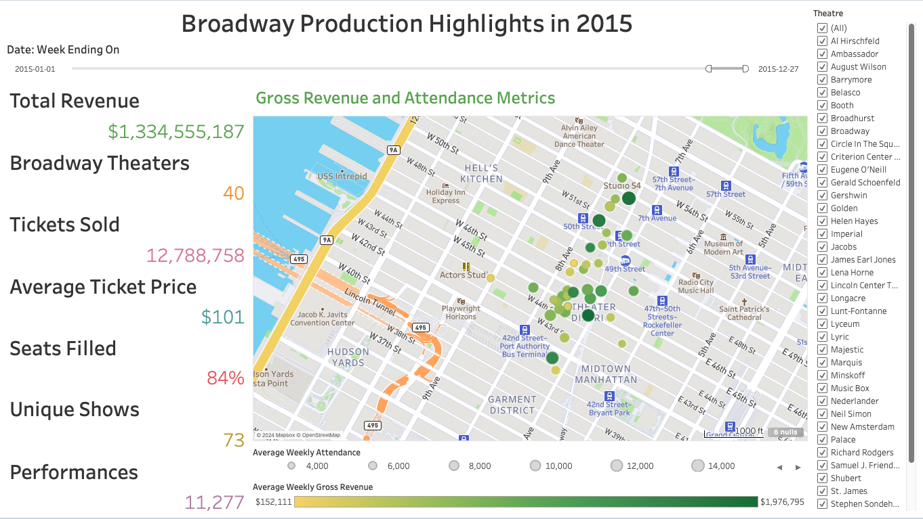
Broadway By the Numbers
1
$1.578 Billion
2
12.28 Million
Gross earnings for the 2022-23 Broadway season.
Total attendance for the
2022-23 season.
3
$4.3 Million
4
$238
Highest single-week gross by The Lion King in 2023.
Highest average ticket price for Merrily We Roll Along.
Time: 1 min 30 sec
Notes:
Carlos

Slide 4
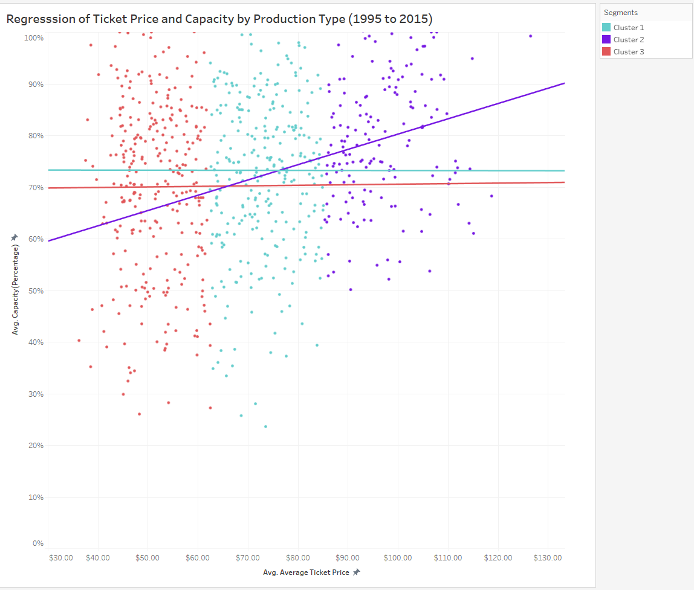
Time: 1 min 45 sec
Notes:
Carlos

Slide 5



Optimizing Ticket Pricing and Capacity
Historical Data Analysis
Dynamic Pricing Strategies
Optimize Revenue per Total Seats =
Increased Profits
Time: 2 min 15 sec
Notes:
Carlos

Slide 6
Dashboard and Demo
Time: 4 min
Notes:
Amy

Slide 7
Preprocessing
Raw Dataset
1
A flat CSV table from 1990-2015 with limited scope.
2
Data Structure Issues
Data Augmentation
3
Normalization, standardization, missing time series, incomplete reporting, redundancies, white space.
Manual data collection and use Python and a geocoding API to normalize theatres and enhance dataset for map visualizations.
Data Preprocessing Steps Log: https://acrobat.adobe.com/id/urn:aaid:sc:us:689f62b3-c5ee-47bb-9cc5-5efb97d5a943
Time: 4 min 30 sec
Notes:
Amy

Slide 8
Data Dictionary
* Calculated fields
Metric | Description
Record ID | Record number, assigned in raw data. One unique number per row.
Full_Date | Date of the last day of the week. Each date represents one week.
Year | Year of the performance
BroadwayProduction | Name of Broadway show.
Theater | Name of theater where the show was hosted.
Address | Address of the theater.
Latitude and Longitude* | Location of the theater, calculated using a geocoding API.
Weekly Performances | Number of individual shows in each week.
Weekly Attendance | Number of tickets sold in the given week, i.e., patrons in seats.
PercentageOfCapacity | Percentage of total seats occupied by ticket holders.
Weekly Gross Revenue | Total box office sales for a performance or week.
Average Ticket Price | Average price of all tickets sold per week.
Average Price per Ticket* | SUM([Weekly Gross Revenue]) / SUM([Weekly Attendance])
Avg Attendance Per Performance* | SUM([Weekly Attendance]) / SUM([Weekly Performances])
Avg Available Seats Per Performance* | SUM([Weekly Attendance]) / (AVG([Capacity(Percentage)]) * SUM([Weekly Performances]))
Avg Gross Per Performance* | SUM([Weekly Gross Revenue])/SUM([Weekly Performances])
RevPAS* | Revenue per Seat—total possible dollars for each seat.
Time: 5 min
Notes:
Amy

Slide 9
Key Takeaways
1. Keep it simple stupid! (KISS)
For example, we converted capacity to a percentage when we could have used Tableau to show it as a percentage.
2. Leverage Tableau to do the heavy lifting.
Tableau has many powerful analysis, visual, and formatting options. Use them to investigate and highlight the key points instead of independent analysis or mental gymnastics to get to the point.
3. Use visual storytelling to tell the customer's story.
Consider the customer’s perspective, what would be of interest to them, and insider metrics (i.e., RevPAS).
Time: 5 min 30 sec
Notes:
Amy

Slide 10
References
Broadway League: Internet Broadway Database: https://www.broadwayleague.com/research/statistics-broadway-nyc/
Broadway League: Sample Metrics Report (2018-2023): /https://www.broadwayleague.com/static/user/admin/media/statistics_broadway_2022-2023_5-season-detail.pdf
Chat GPT-4: https://chat.openai.com/
Class presentations—Professor Ralph, Spring 2024
Dataset Source: https://corgis-edu.github.io/corgis/csv/broadway/
GeoJSON Forman (with technical links): https://geojson.org/
Google Colabs: https://colab.research.google.com/
Google Dataset Search:: https://datasetsearch.research.google.com/
Learning Tableau 2022, By Joshua N. Milligan: https://download.packt.com/free-ebook/9781801072328
Open Cage: https://opencagedata.com/
Opening the Stage Door for Big Data in Broadway — Building Databases from unstructured text: https://yaakovbressler.medium.com/opening-the-stage-door-for-big-data-in-broadway-20ca3e35a274
Python: https://www.python.org/
Storytelling with Data: A Data Visualization Guide for Business Professionals 1st Edition, by Cole Nussbaumer Knaflic: https://www.storytellingwithdata.com/books
Time: 5 min 45 sec

Slide 11
Q & A
Details

Slide 12
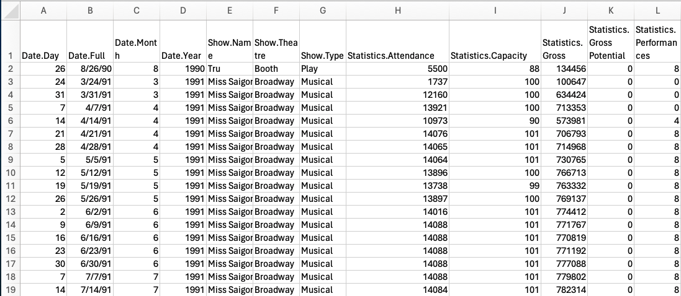
Raw Dataset

Slide 13
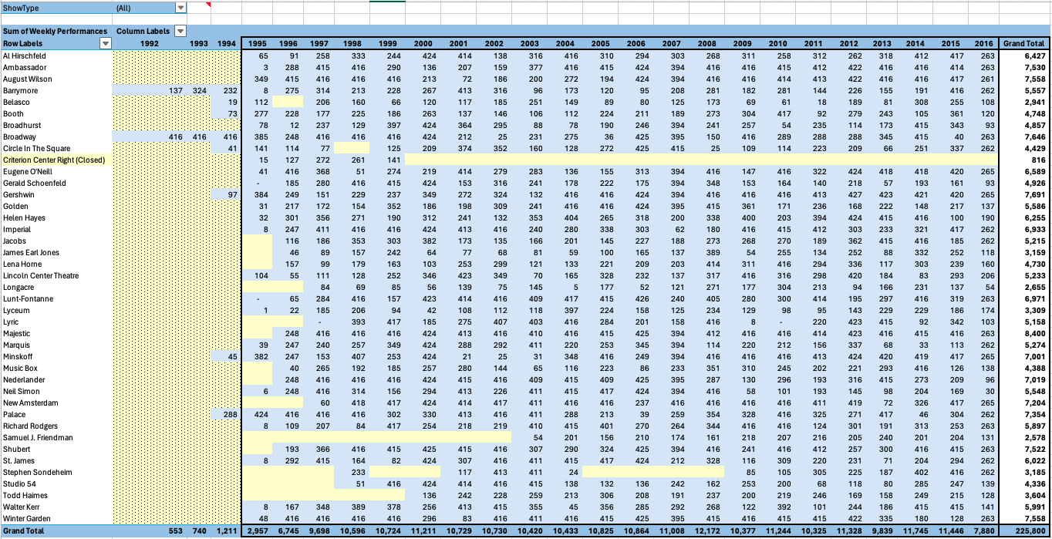
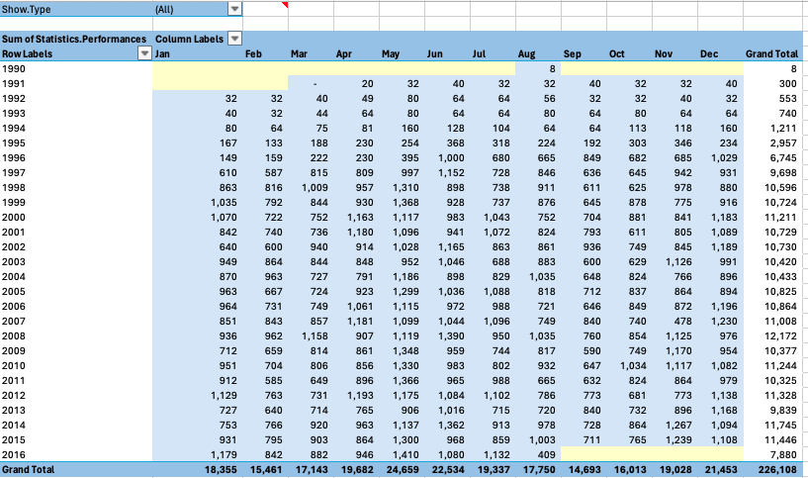
Preprocessing
in Excel

Slide 14
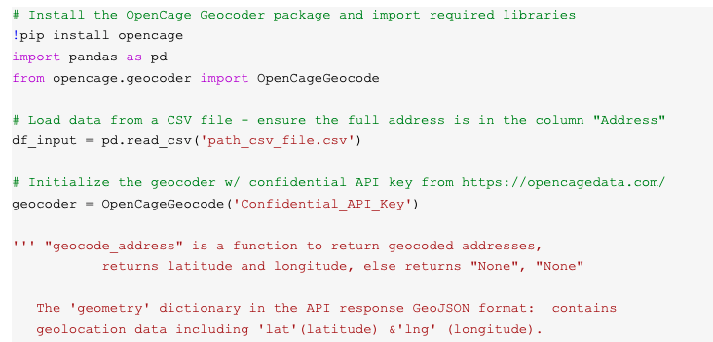
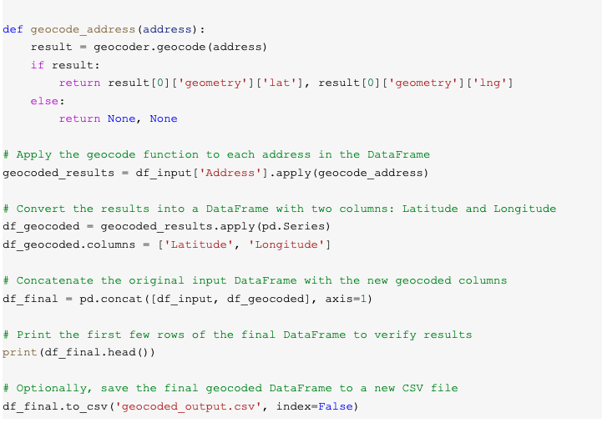
Preprocessing
in Python: CODE for
Geocoding “Address”

Slide 15
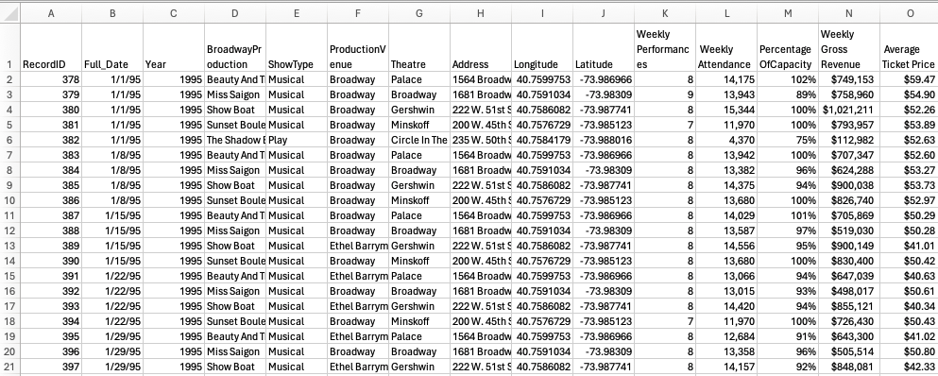
Final Dataset

